Slide 1

Sentiment Analysis of Reviews
Juârez Acoustic Guitar (Amazon Product)
P107 – Group 3
Group Members:-
Kiran Shantaram More
Jacquline
Revati pundlik shingole
Gavhane gitanjali Prakash
Ganesh Sandip Ghanade
Ritesh Shrivastava

Slide 2

Business Problem:
Objective:
Most of the people are expressing their views by posting it on social platforms about a product. We need to understand the liking or disliking of that product to help the organization to make some decisions about the production and supply of the same in the market. So here consider extracting reviews from any social platform or from ecommerce websites and analyze them to satisfy the object.

Slide 3
Project Flow
Dataset collection
Text preprocessing, text cleaning
Subjectivity/Polarity and collecting sentiment
Word cloud
Initial Insight collection
Model building and comparison
Deployment

Slide 4
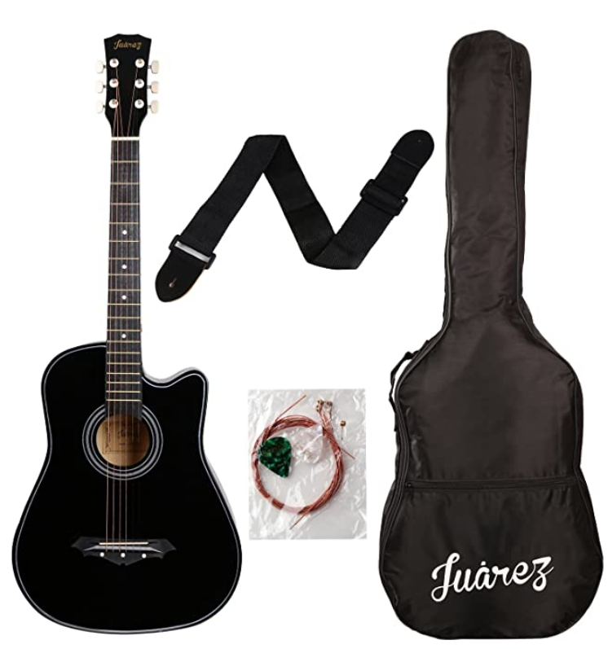
Product selected for amazon reviews
Juârez Acoustic Guitar, 38 Inch Cutaway, 038C with Bag, Strings, Pick and Strap, Black

Slide 5
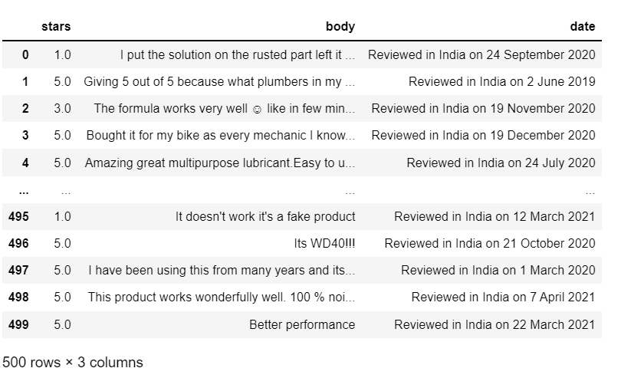
Data set details
There is no any dataset provided. So we used web scraping to collect the data for a product from amazon. We used:
Requests – This module is used to collect the html data from amazon product review pages with get method and necessary headers.
BeautifulSoup – This module is used to parse the HTML collected using requests.

Slide 6

Text preprocessing, text cleaning
HTML tags removal
Remove punctuations
Remove hyperlinks
Resolve contractions
Convert numbers to text
Covert to lower case
Stemming
Lemmatization
I reduced complexity of data and got useful + efficient format of data

Slide 7

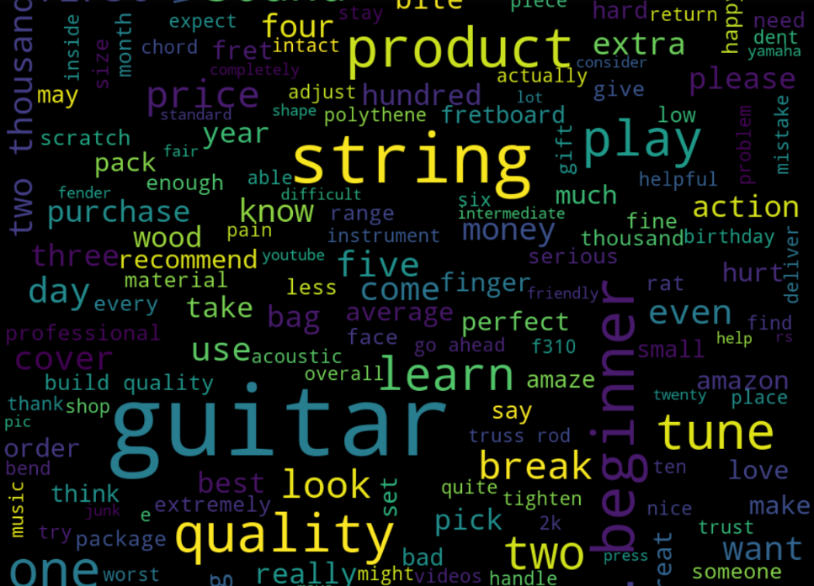
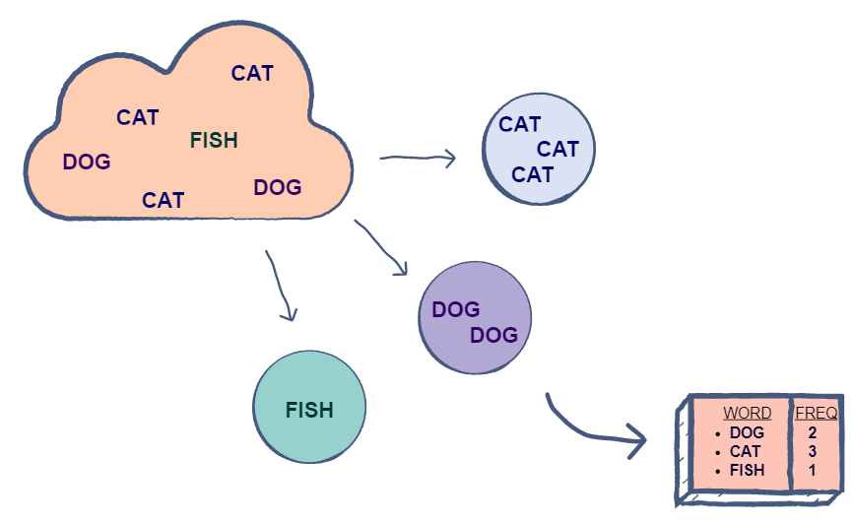
Collecting initial analysis
FreqDist - frequency distribution of all the words in the text
Wordclouds - frequency or the importance of each word
- Overall wordcloud
- Positive words wordcloud
- Negative words wordcloud

Slide 8
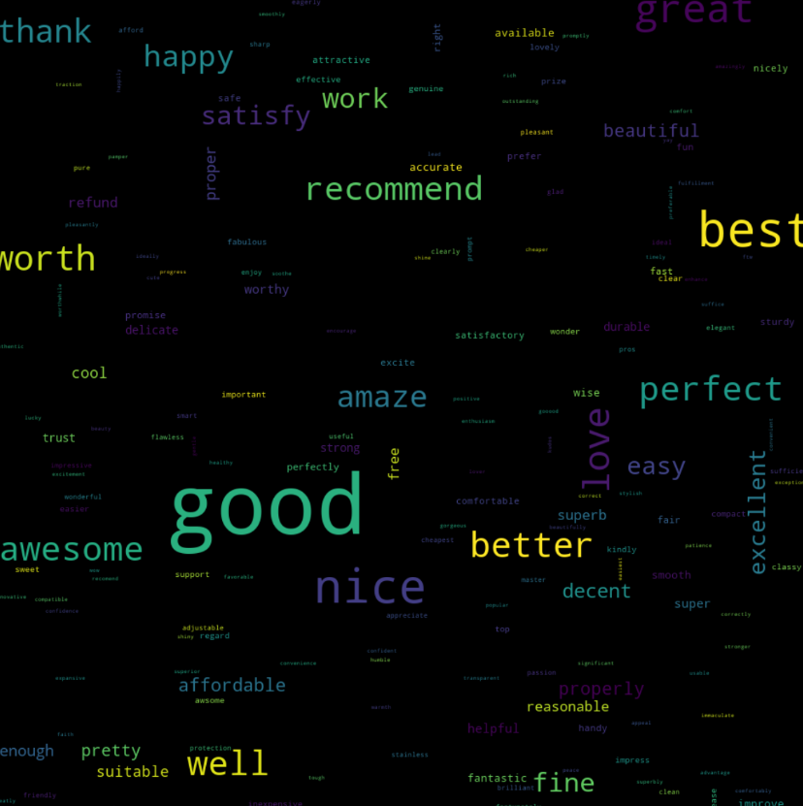
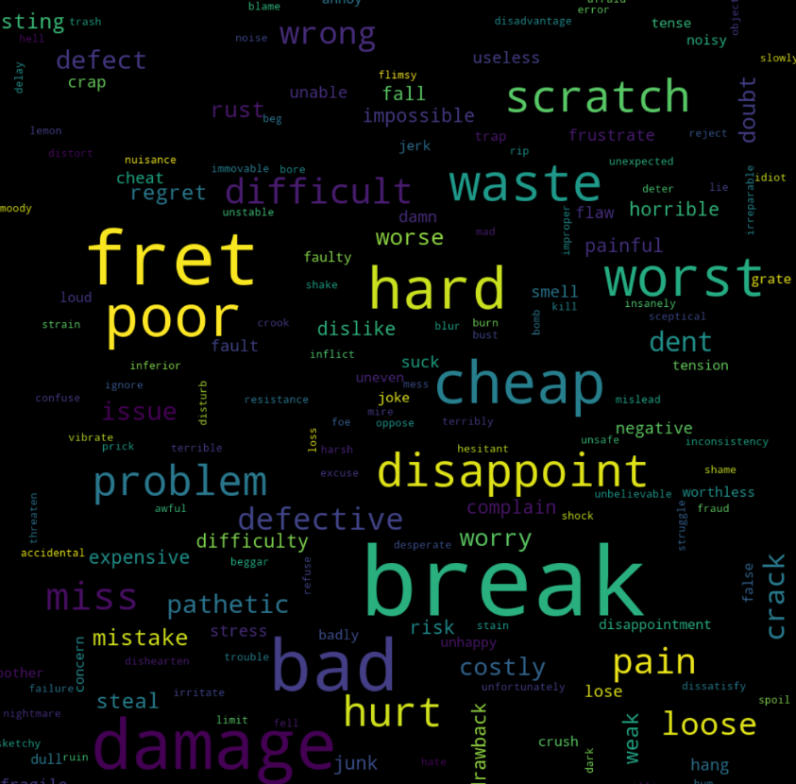
Collecting initial analysis (cont.)
Many people are liking the product. They are talking about the qualities like worth, recommend, easy, affordable etc.
Many people are complaining about scratch, hard, cheap, break, damage.
There are more positive words than negative.

Slide 9

Sentiment Analysis using TextBlob
TextBlob returns polarity and subjectivity of a sentence.
We used polarity of each cleaned review to get the sentiment behind it like positive/negative/neutral.
Later we removed the records with neutral sentiment, as we are not interested in neutral reviews.

Slide 10
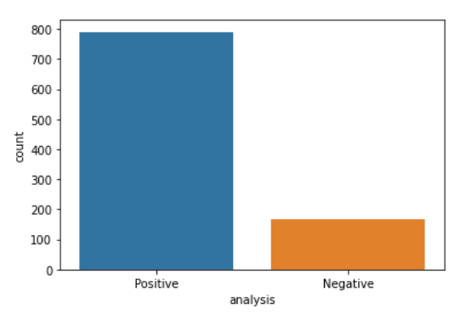
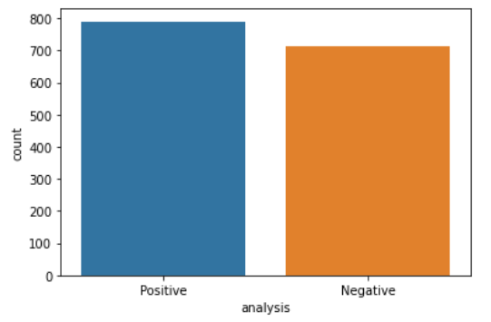
Data balancing
Mildly imbalanced data
RandomOverSampler - Random oversampling duplicates examples from the minority class in the dataset.
Before balancing
After balancing

Slide 11
Vectorization – TF_IDF
As our data is available in text format, we need to convert it into a set of real numbers (a vector)
We used TF-IDF. Other methods are also there like BOW, Word2Vec . We used TF-IDF because it’s more agreeable for ML & NLP techniques.

Slide 12
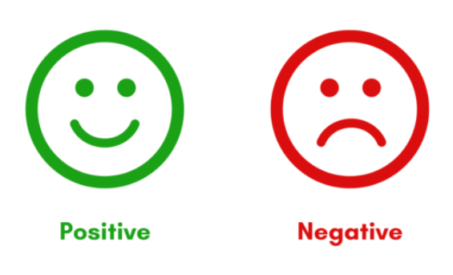
Model Building – Text classification
SVM
Logistic Regression
Naive Bayes
Decision Tree
KNN

Slide 13
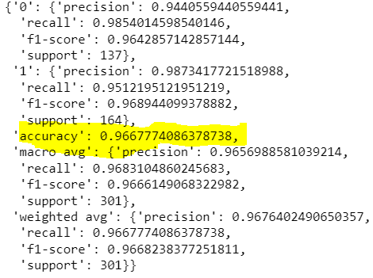
SVM
Accuracy – 96%

Slide 14
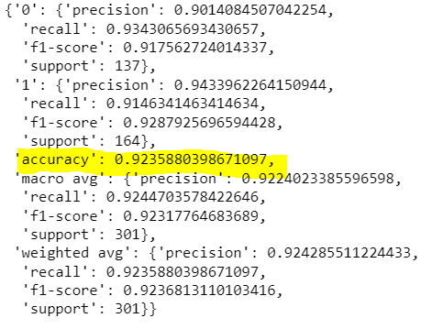
Logistic Regression
Accuracy – 92%

Slide 15
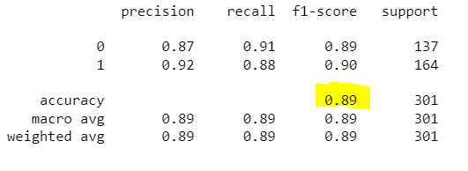
Naive Bayes
Accuracy – 89%

Slide 16
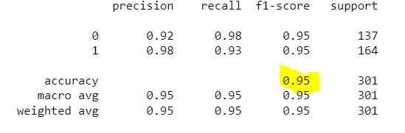
Decision Tree
Accuracy – 95%

Slide 17
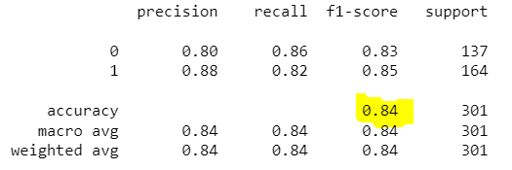
KNN
Accuracy – 84%

Slide 18
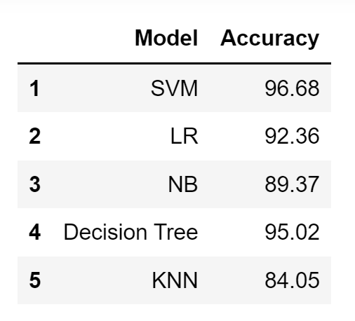
Model Accuracy
With multiple test cases, we found SVM is giving better result maximum times. So we took it as a final model for deployment.

Slide 19
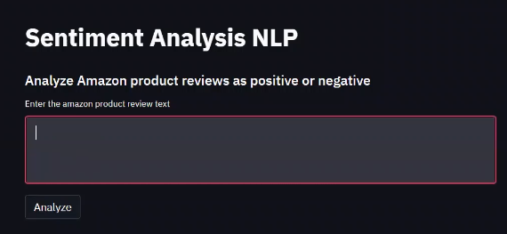
Deployment using Streamlit
Step 1:

Slide 20
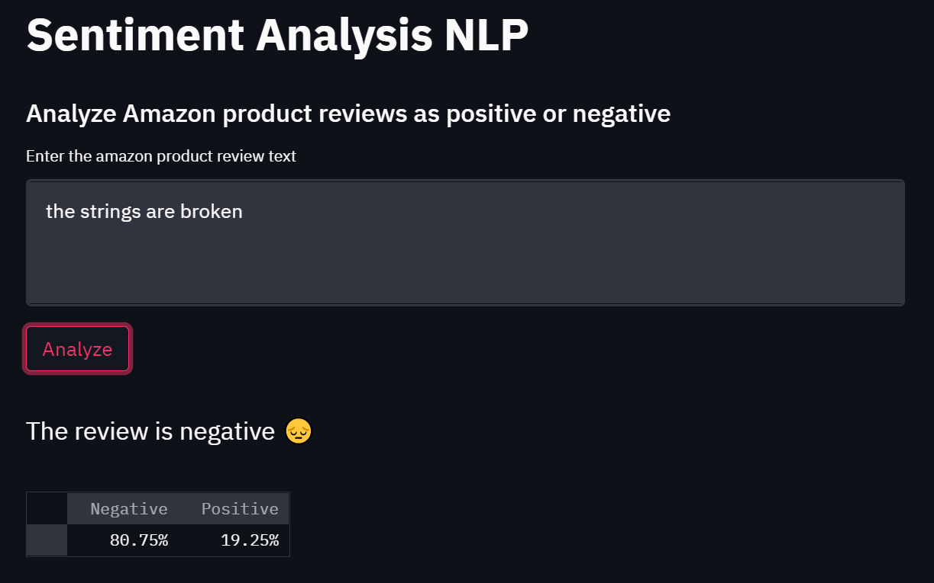
Deployment using Streamlit (cont.)
Step 2:

Slide 21
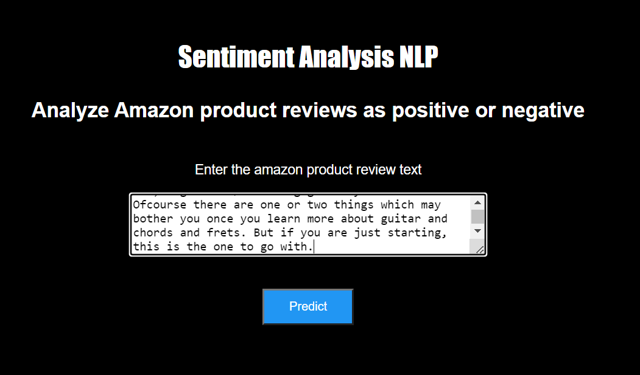
Deployment using Flask
Step 1:

Slide 22
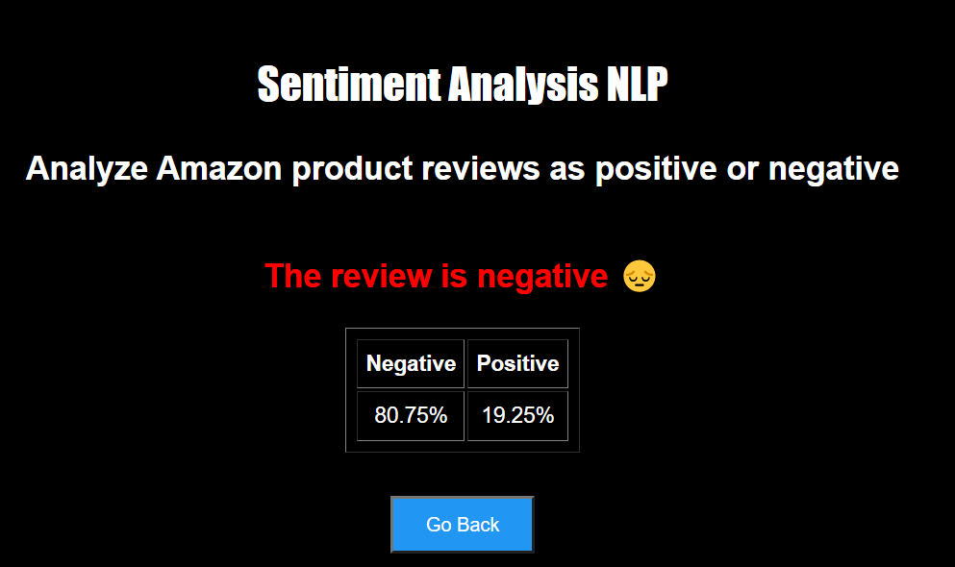
Deployment using Flask (cont.)
Step 2:

Slide 23
Challenges faced?
Selecting a product for reviews – The web scraping script was hanging sometimes for large no. of records. So we needed to put enough time for selecting a product not with much lengthier reviews and also with lesser frequency of scraping.
Understanding objective/final output of the project. We were not sure whether model building will be part of this project or not. But during the review meeting, we got this cleared by mentor.
Deployment – Streamlit was not covered completely during online sessions. So we needed to research on it.
Team work – We were lacking in team work.

Slide 24
Thank you!

